Slide 1
基於時序金字塔之第一人稱影像行為辨識 Activity Recognition in First-Person Camera View Based on Temporal Pyramid
Speaker: Hsaun-Ming Liu
Advisor: Ming Ouhyoung, Ph.D

Slide 2
Outline
Introduction
Related work
System Overview
Method
Experiments & Results
Demo
Conclusion

Slide 3
Introduction

Slide 4
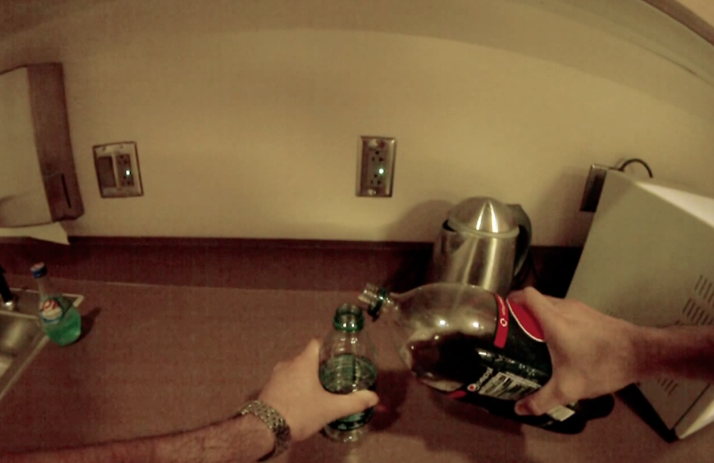

Problem Definition
First-Person-View Videos
Ongoing Activity
Notes:
當我們擁有第一人稱影片,如何去辨識畫面中主角正在從事的行為

Slide 5
Problem Definition
First-Person-View Videos
Activity of Daily Life
Eating,
Drinking,
Laundry,
etc.
Notes:
在碩論中先限縮問題範圍

Slide 6
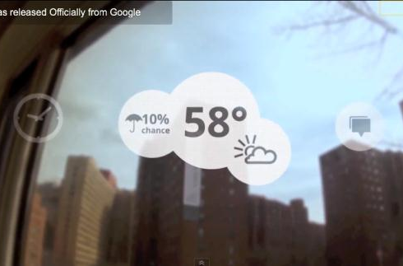
Motivation
Multimodal Context Aware Service

Slide 7
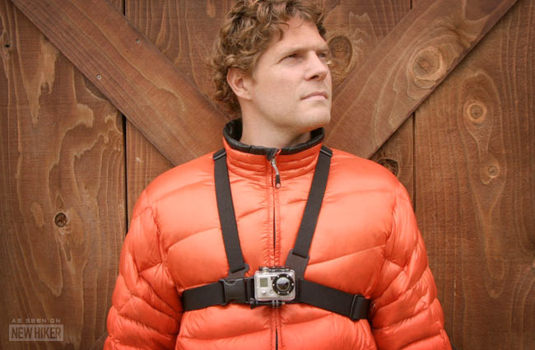

The Time has Come
Device : GoPro camera, Google Glass

Slide 8
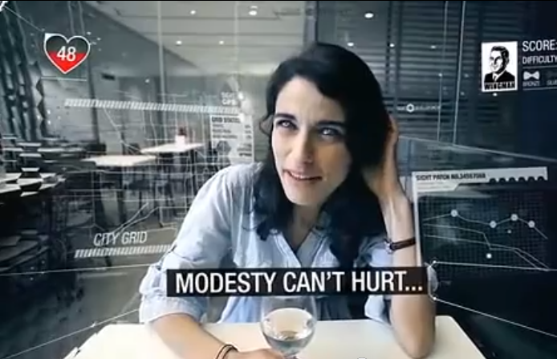
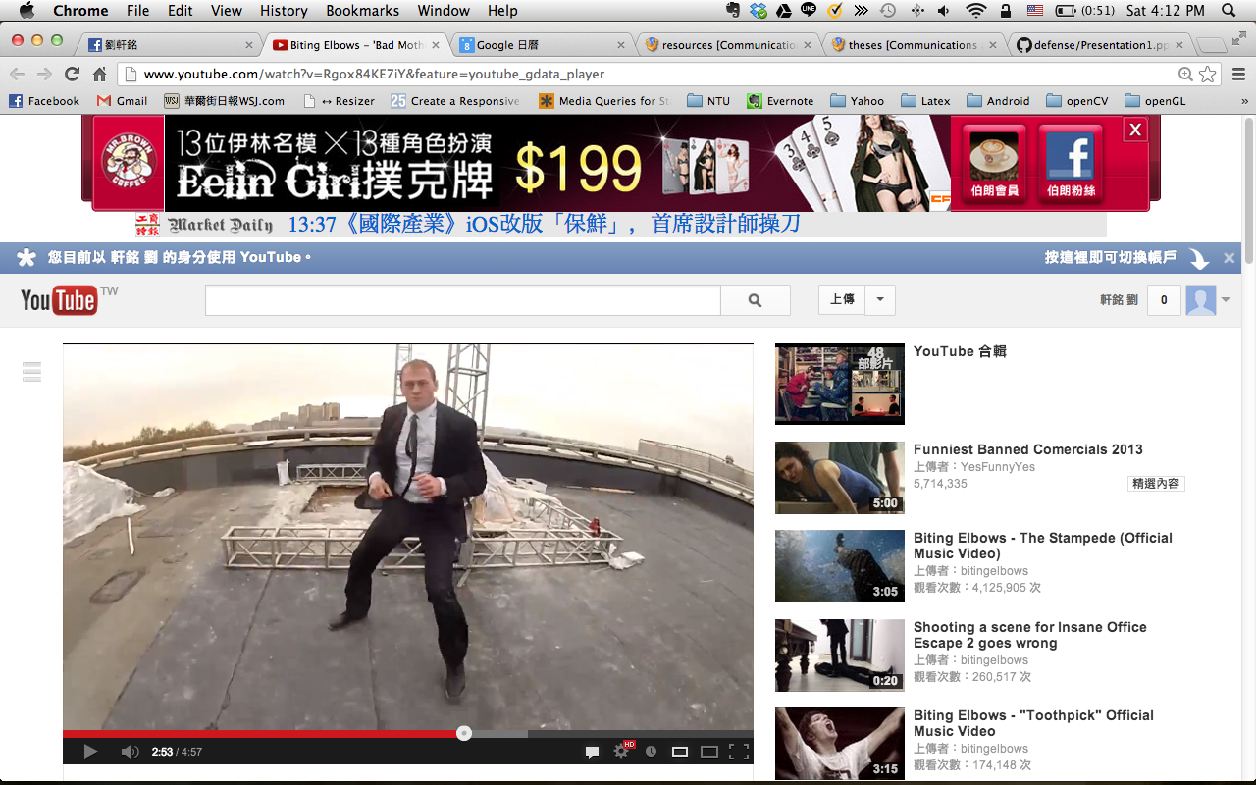
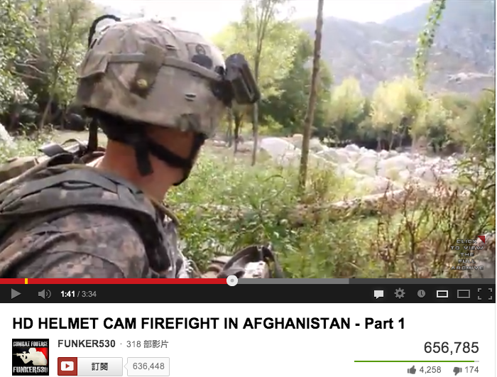
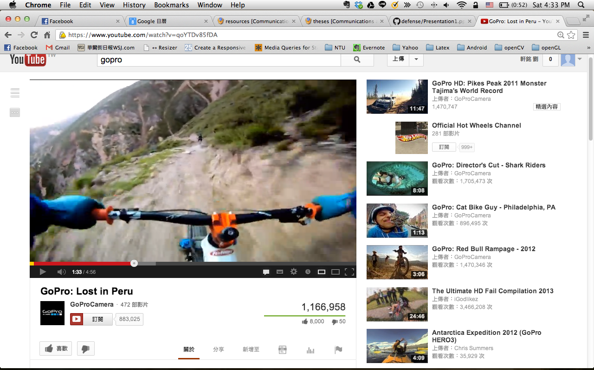
The Time has Come
Contents

Slide 9
The Problem
Properties of Activities of Daily Life
Good Part | Bad Part
Sequential | Interleaved/Co-occurrence
 | variation in duration

Slide 10
The Problem
Properties of Activities of Daily Life
Good Part | Bad Part
Sequential | Interleaved/Co-occurrence
 | variation in duration
Temporal Pyramid,
Sequence Finding
Conditional Random Fields

Slide 11
Related Work

Slide 12
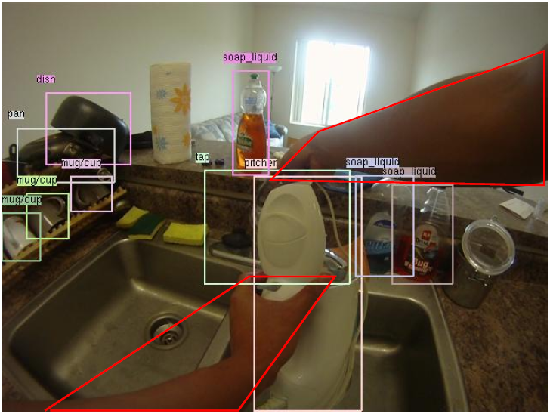
Related Work
Conditional Random Fields for Activity Recognition [Vail et al., 07]
Detecting Activities of Daily Living in First-person Camera Views [Pirsiavash et al., 12]
Notes:
Conditional Random Fields for Activity Recognition:
In cases where features depend on observations from many time steps, we confirm that CRFs are robust against any degradation in performance
在機器人領域” In the robot tag domain, we wish to identify which robot is the seeker at each time step of the simulation”, features: Raw Positions, Velocities,

Slide 13
System Overview

Slide 14
System Overview
detector
feature vector
(segment)
new frame
. detector
feature vector
obj. detector
similar with the latest segment?
new features
no
features
new features
features
features
features
new features
yes
discard
Merge and Build
new features
features
new features
Laundry stage_1
features
features
new features
Laundry
stage_2
features
Refresh
Inference

Slide 15
Method

Slide 16
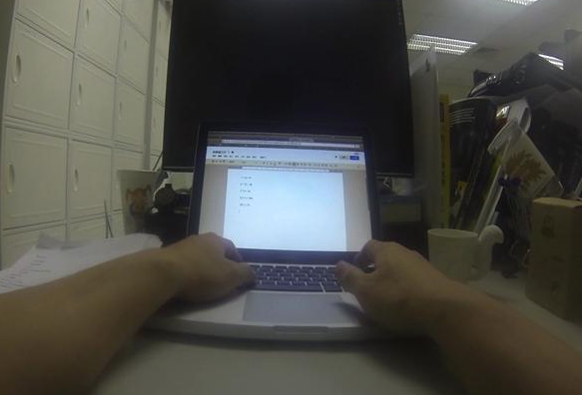
Visual Phrase Object Feature
Active Laptop
Passive Cup

Slide 17
Visual Phrase Object Feature
It’s all about objects
Detecting Activities of Daily Living in First-person
Camera Views [Pirsiavash et al., 12]
Activity Recognition in the Home Using Simple
and Ubiquitous Sensors [Tapia et al., 04]
An emerging pattern based approach to activity
recognition [Gu et al., 09]

Slide 18
Visual Phrase Object Feature
Improvements in object detection
Recognition Using Visual Phrases [Sadeghi et al., 11]

